Slide 1

Introducing Microsoft Azure
Demystifying and getting started in the Azure Portal

Slide 2
Who this is aimed at
Developers and IT Professionals who:
Have no prior experience with Azure
May or may not have experience with alternative cloud platforms

Slide 3
In this session
Navigating the portal for beginners
Creating resources for the first time
Concepts and acronyms
NOT in this session
Azure vs AWS vs GCP vs others
Automation and ARM Templates
Azure DevOps CI/CD services
Azure CLI
Classic Portal (legacy)

Slide 4
What is Microsoft Azure?
Microsoft’s hosted Cloud Platform
Provision services in Microsoft’s data centers
Storage
Compute
IAAS, PAAS, Serverless, Container registry and hosting

Slide 5
Subscriptions – Key Concept
All resources must belong to a subscriptions
Subscriptions can be used to separate billing and environment tiers

Slide 6
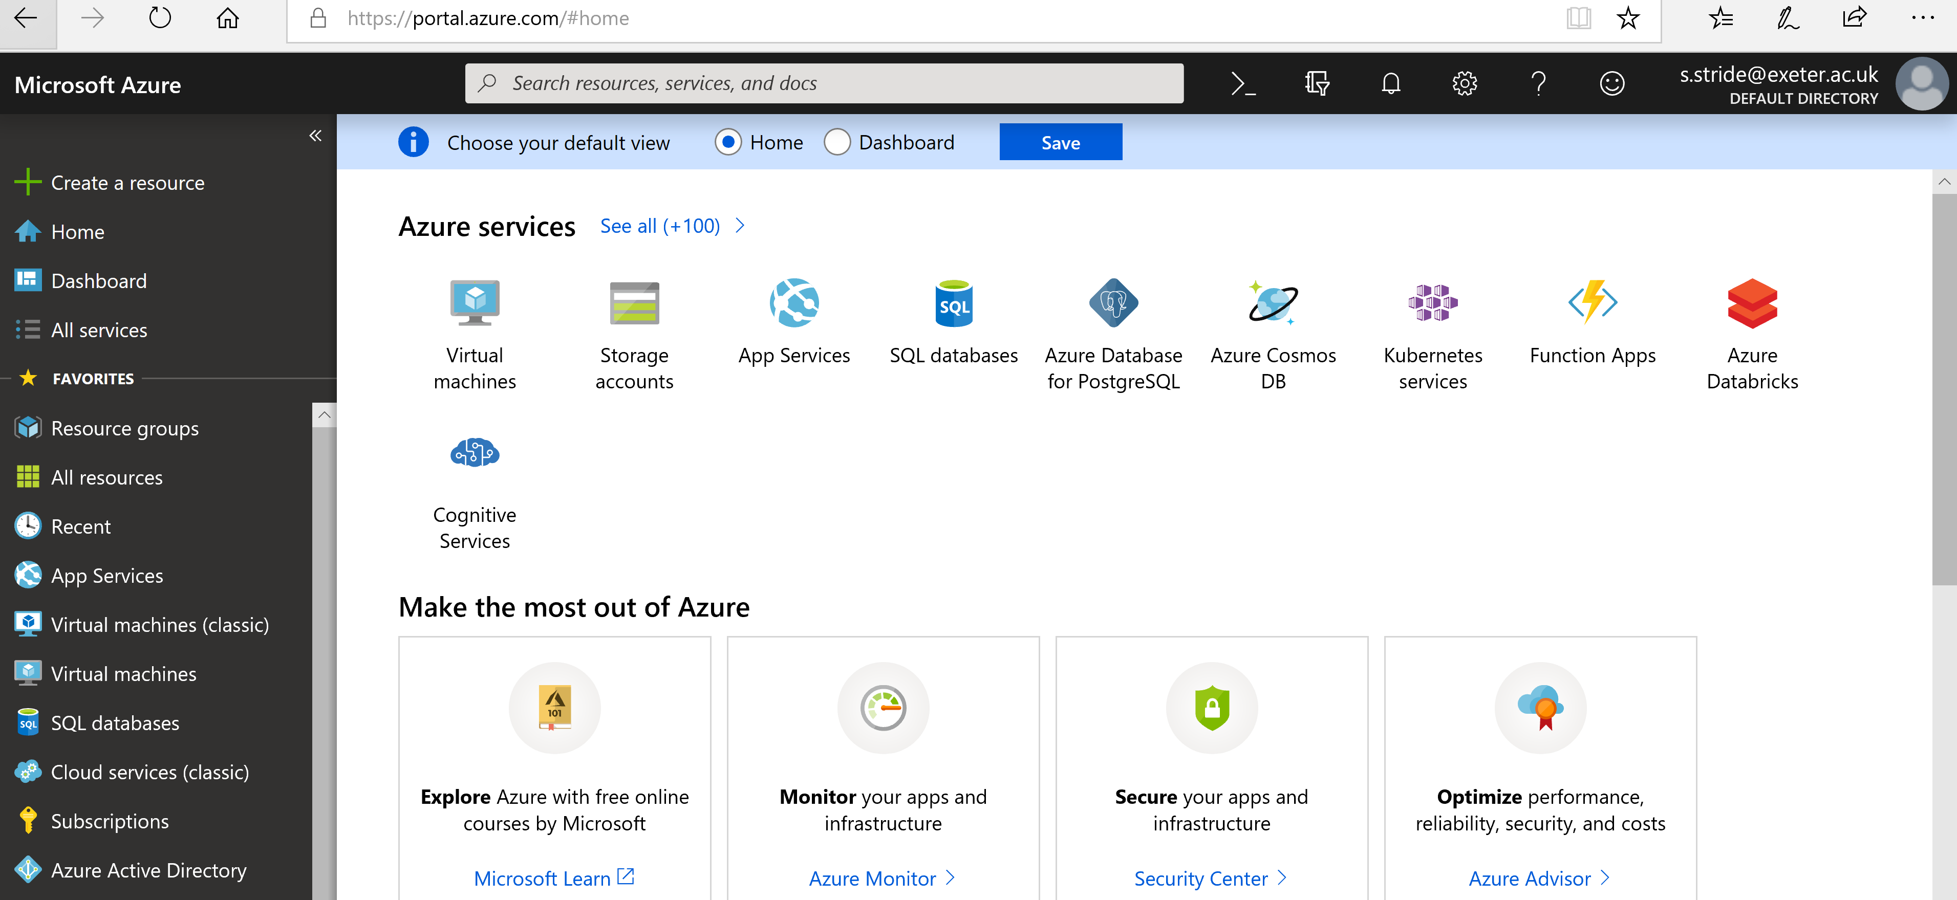
Demo – Logging In
Logging in, panels, notifications, account

Slide 7
Resource Groups – Key Concept
Logical container for grouping related resources
E.g. all resources relating to a specific application service/business function
All resources MUST belong to a Resource Group
Not necessarily suitable for dividing dev/test/prod – depending on subscription approach
Deleting a resource drops all contained applications and services

Slide 8
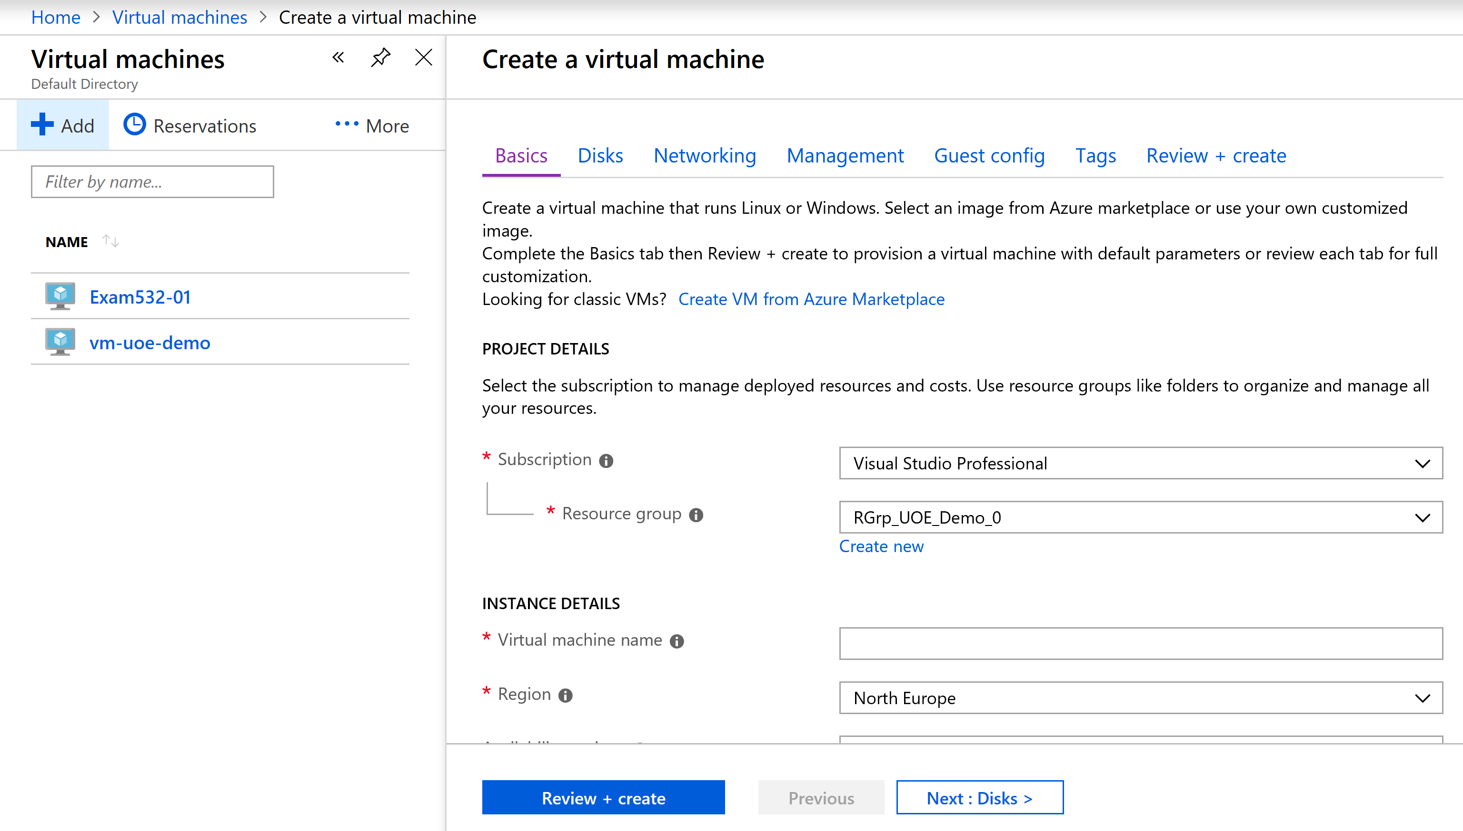
Demo – Creating a VM

Slide 9
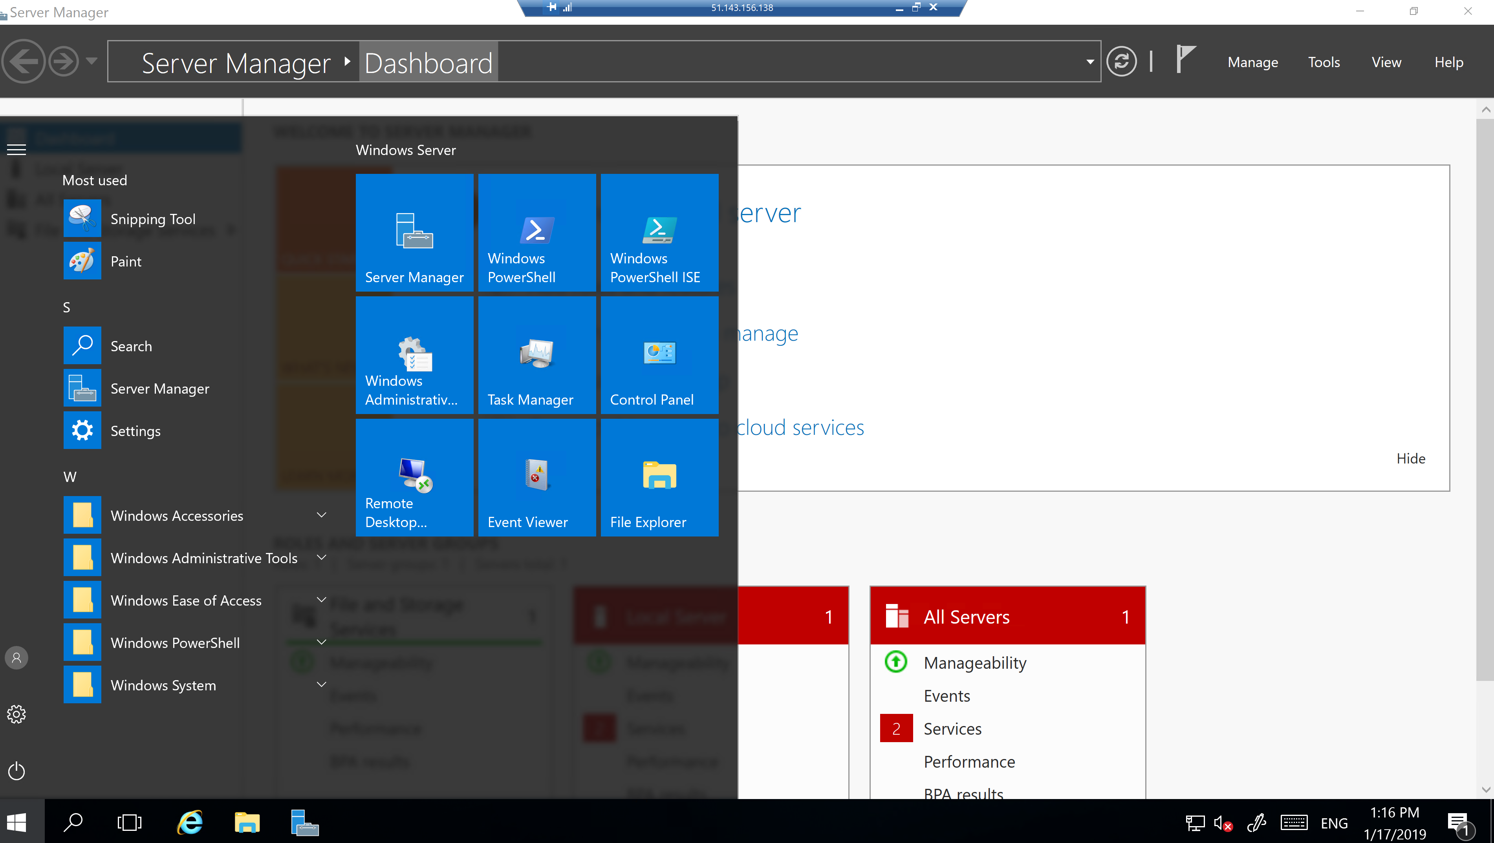

Slide 10
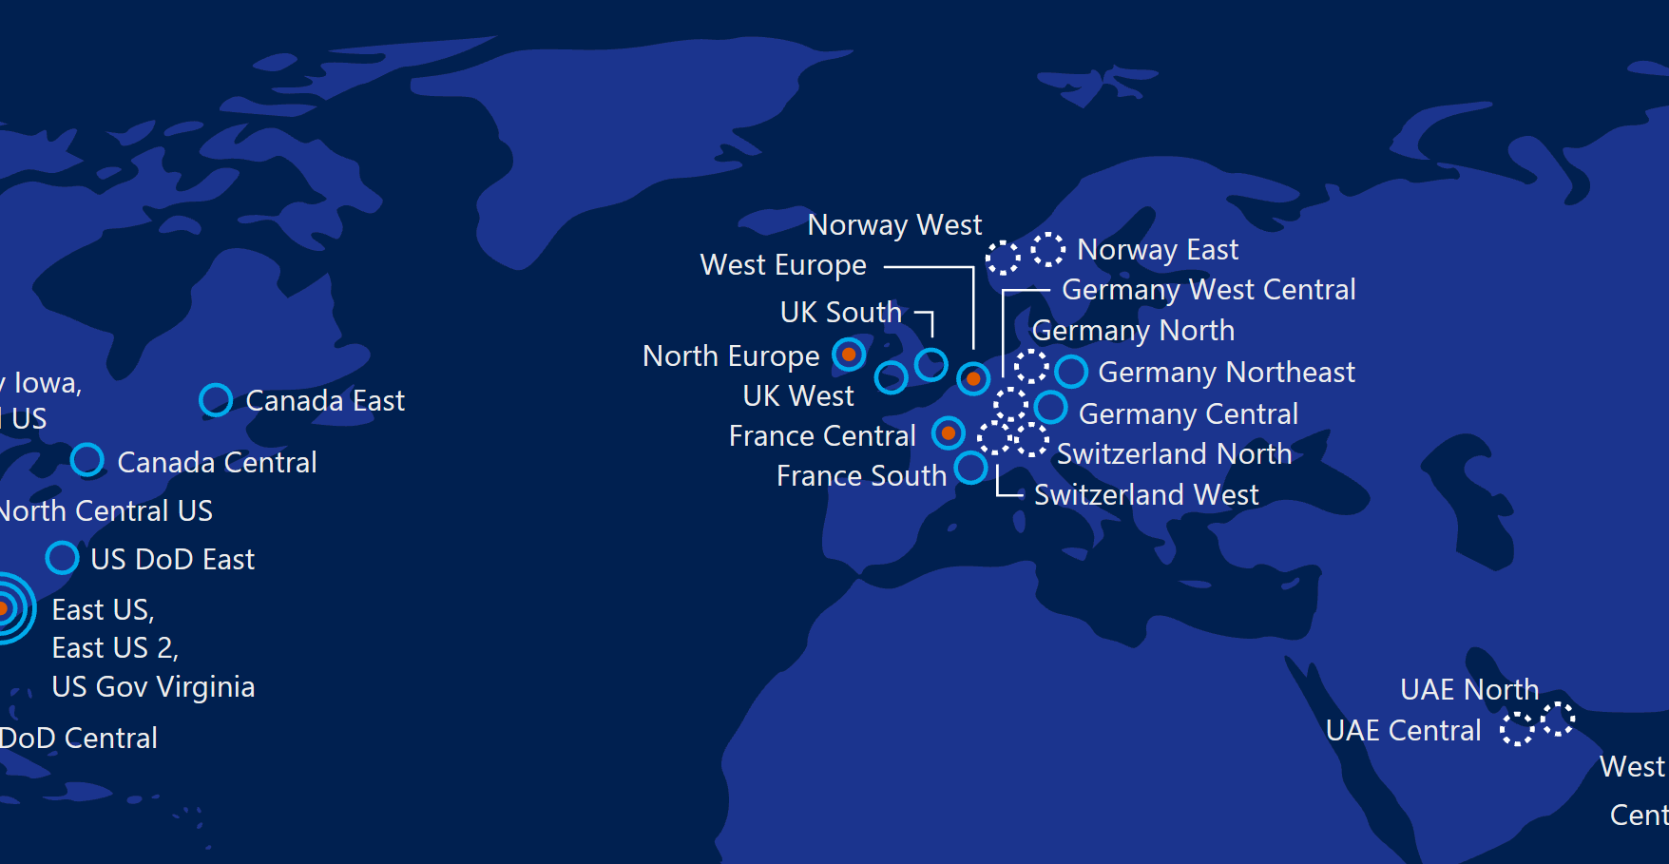
Data Centers/Regions
Microsoft has data centers all over the world, which allows for geo redundancy and minimising network latency
Pick a data center close to where your service will be delivered
Not all services are available in all regions
Pricing for some services vary by region

Slide 11
Pricing
Guesstimate resource costs in advance
https://azure.microsoft.com/en-gb/pricing/calculator/
Put together a POC to check that you have all the components you need – virtual networks, load balancers, availability replicas add “hidden” costs that may not be obvious at design time

Slide 12
Acronyms and Jargon
IAAS – Infrastructure As A Service
VMs for you to install just like the on-prem equivalent
Suitable for minimal change compare to existing setup
Windows and Linux options available
PAAS – Platform As A Service
Specific software without underlying OS
E.g. Azure SQLDB = SQL Server endpoint without (access to) the VM
Serverless – just run the code as a function
Containers – isolated deployment units

Slide 13
How to Get a Subscription
Sign up for free (credit card required) and get £150 credits
https://azure.microsoft.com
Enterprise MSDN Subscription
Ask your manager (licenses managed as part of MS contract)
Corporate Account…. Maybe!

Slide 14
Where To Go Next
Get a subscription and some credits then experiment!
https://azure.microsoft.com
Azure Portal
https://portal.azure.com
Pluralsight videos
https://pluralsight.com
Regions/Data Center Locations
https://azure.microsoft.com/en-us/global-infrastructure/regions/
Pricing Calculator
https://azure.microsoft.com/en-gb/pricing/calculator/

Slide 15
Thanks!
Simon Stride
s.stride@exeter.ac.uk

